Slide 1

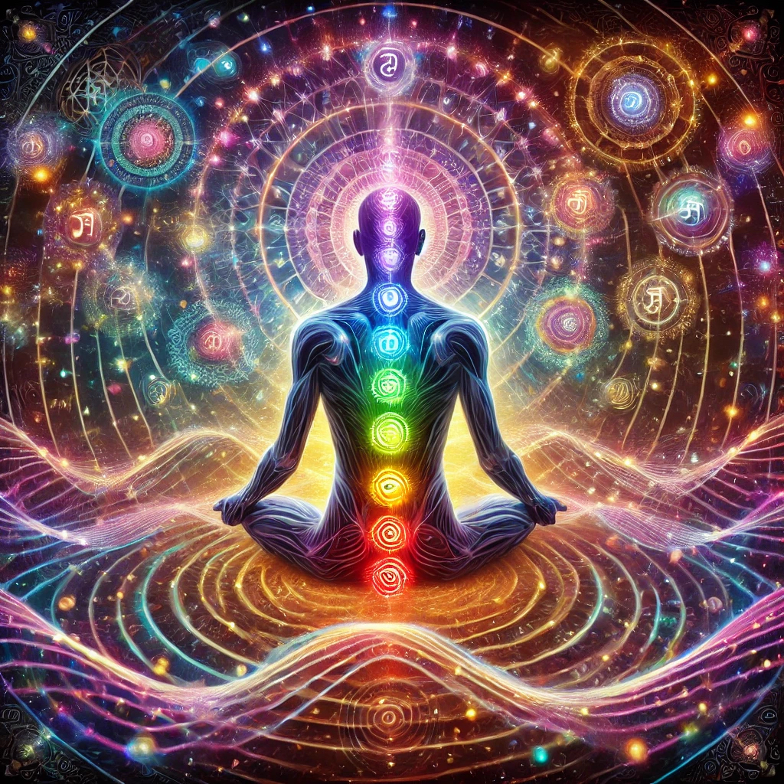
HARMONIC SOUND THERAPY
Patrick Pagano BS, MFA
DIRECTOR SOUTHEAST JUST INTONATION SOCIETY
Sound Therapist & Harmonic Research

Slide 2
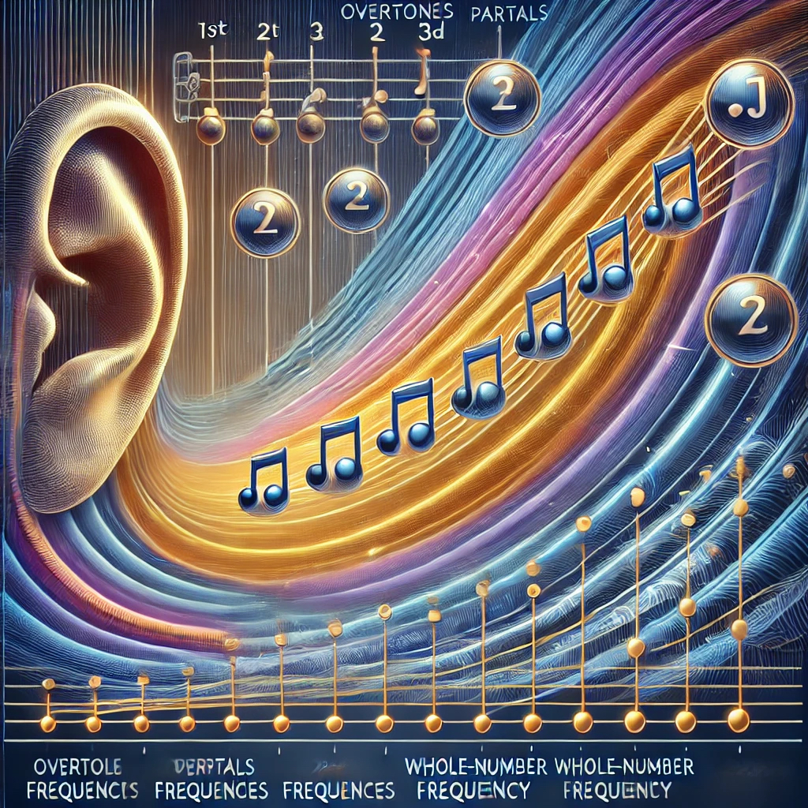
HARMONIC SERIES EXPLAINED
The Harmonic Series in music is a fundamental concept that describes the sequence of overtones (or partials) that occur naturally when a single note is played on a resonant instrument. These overtones are whole-number multiples of a fundamental frequency and are integral to the perception of timbre and pitch. Understanding the harmonic series reveals profound connections between music, human physiology, and neuroscience.

Slide 3

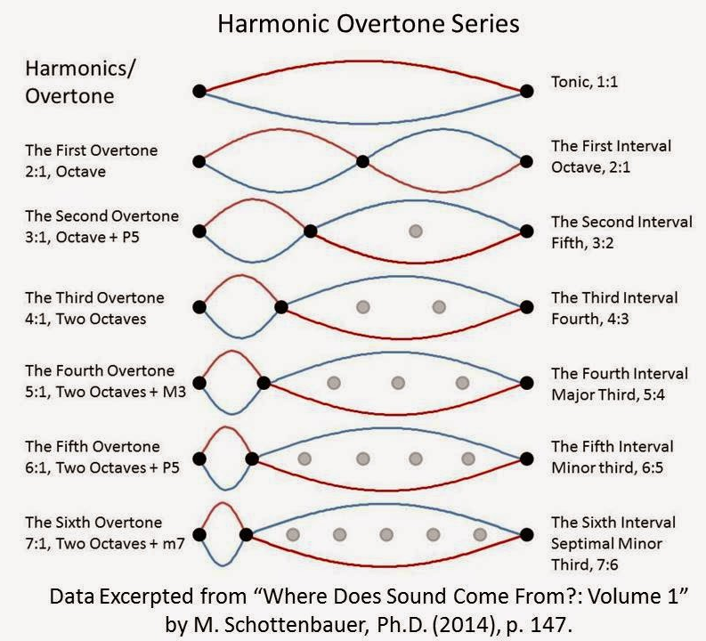
A BASIC HARMONIC SERIES

Slide 4

The Harmonic Series: Overview
Definition: The harmonic series consists of frequencies that are integer multiples of a fundamental frequency. For example, if the fundamental frequency is 100 Hz, the harmonic series would include 200 Hz, 300 Hz, 400 Hz, and so on.
Natural Occurrence: The harmonic series is naturally produced in vibrating systems like strings, vocal cords, and air columns in wind instruments.

Slide 5
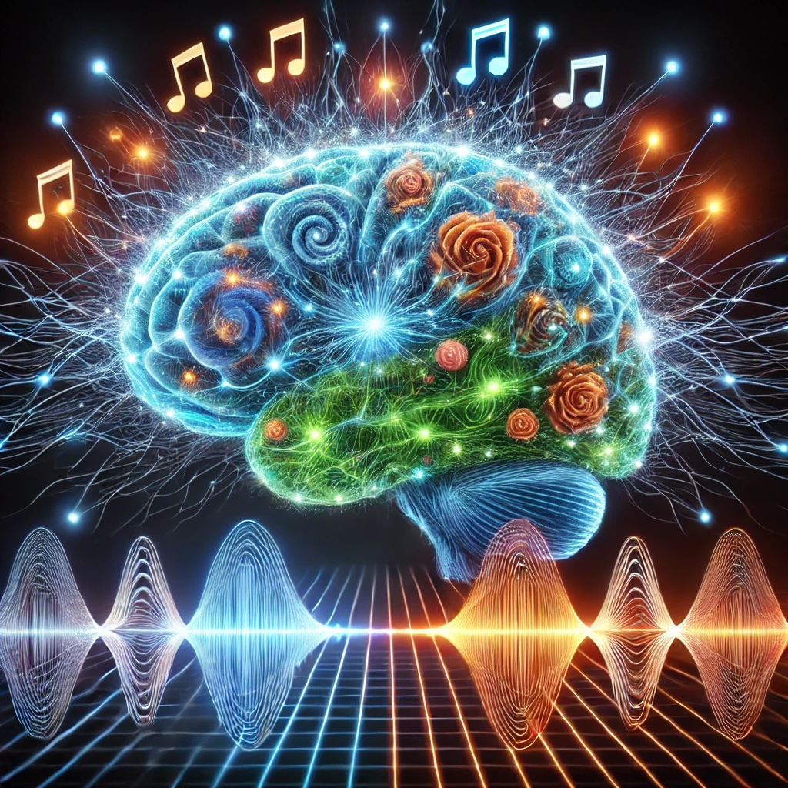
Relation to Human Physiology
Neurological Responses: Studies show that the brain processes harmonic intervals more efficiently than dissonant ones, which may be related to evolutionary mechanisms favoring pattern recognition.

Slide 6
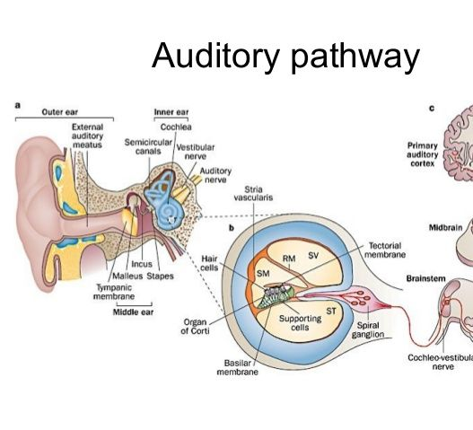
Auditory Perception
Auditory Perception: The human ear and brain are finely tuned to detect harmonic relationships. The cochlea in the inner ear decomposes complex sounds into their harmonic components, allowing the brain to identify timbre and pitch.

Slide 7
Academic and Medical Studies
Study: Bendor, D., & Wang, X. (2005). The neural coding of pitch in primate auditory cortex. Nature.Findings: This study showed that neurons in the auditory cortex are specifically attuned to harmonic relationships. Researchers found that pitch-selective neurons respond most strongly to stimuli containing harmonic overtones, demonstrating the brain's specialized mechanism for processing musical intervals.
Implication: This highlights the deep integration of the harmonic series in human auditory processing, suggesting an evolutionary advantage for detecting harmonic sounds.

Slide 8

Academic and Medical Studies
Harmonic Series and Neural Synchronization
Study: Large, E. W., & Snyder, J. S. (2009). Pulse and meter as neural resonance. Annals of the New York Academy of Sciences.
Findings: This study revealed that rhythmic and harmonic structures in music synchronize neural oscillations in the brain. The harmonic series was shown to play a key role in generating rhythmic entrainment, which enhances attention and emotional response to music.
Implication: Neural synchronization with the harmonic series has implications for therapeutic practices, such as music therapy for neurological disorders.

Slide 9
HARMONICS
The harmonic series is a cornerstone of music theory, but its influence extends deeply into human physiology and neuroscience. It shapes how we perceive and produce sound, connects with our neural mechanisms, and resonates within our bodies. These insights not only deepen our understanding of music but also open avenues for interdisciplinary applications in medicine & psychology.

Slide 10
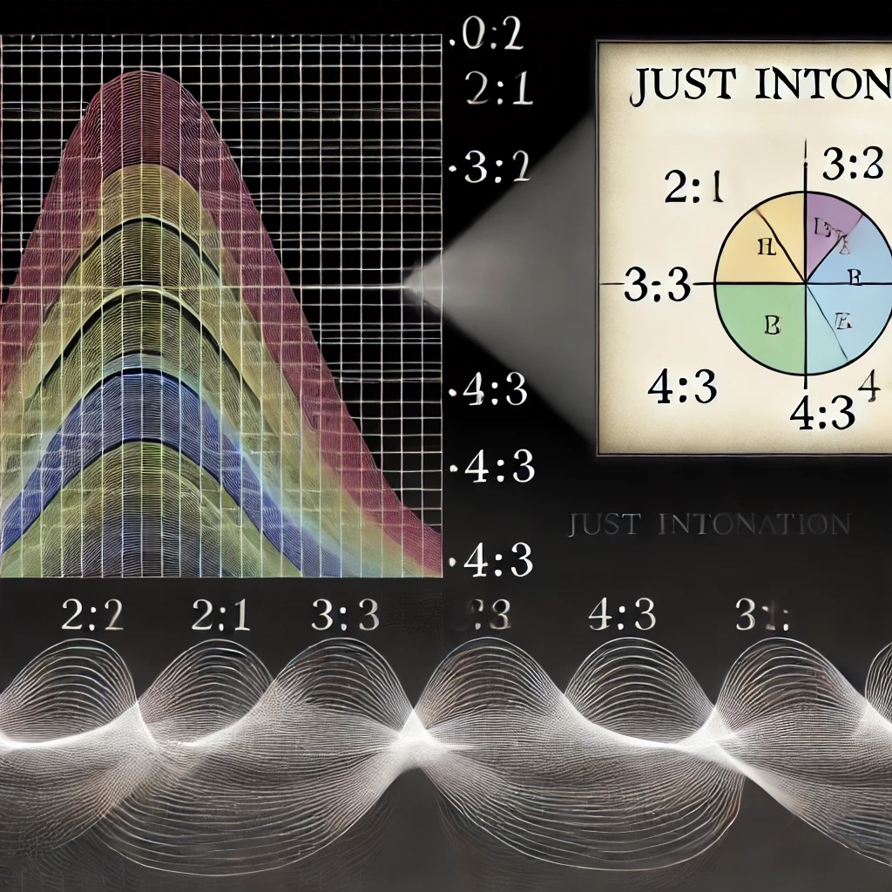
JUST INTONATION
Just Intonation Just Intonation is a tuning system based on the natural harmonic series. It uses ratios of whole numbers to define the relationships between pitches, ensuring that intervals are consonant (i.e., pleasing to the ear due to minimal acoustic beating).

Slide 11
JUST INTONATION
Just Intonation prioritizes harmonic purity based on natural intervals

Slide 12
JUST INTONATION
Just Intonation:
Uses exact whole-number ratios (e.g., 3:2, 5:4) to define intervals, resulting in pure-sounding harmonies
Provides intervals that align perfectly with the harmonic series, producing a more "natural" and resonant sound.

Slide 13
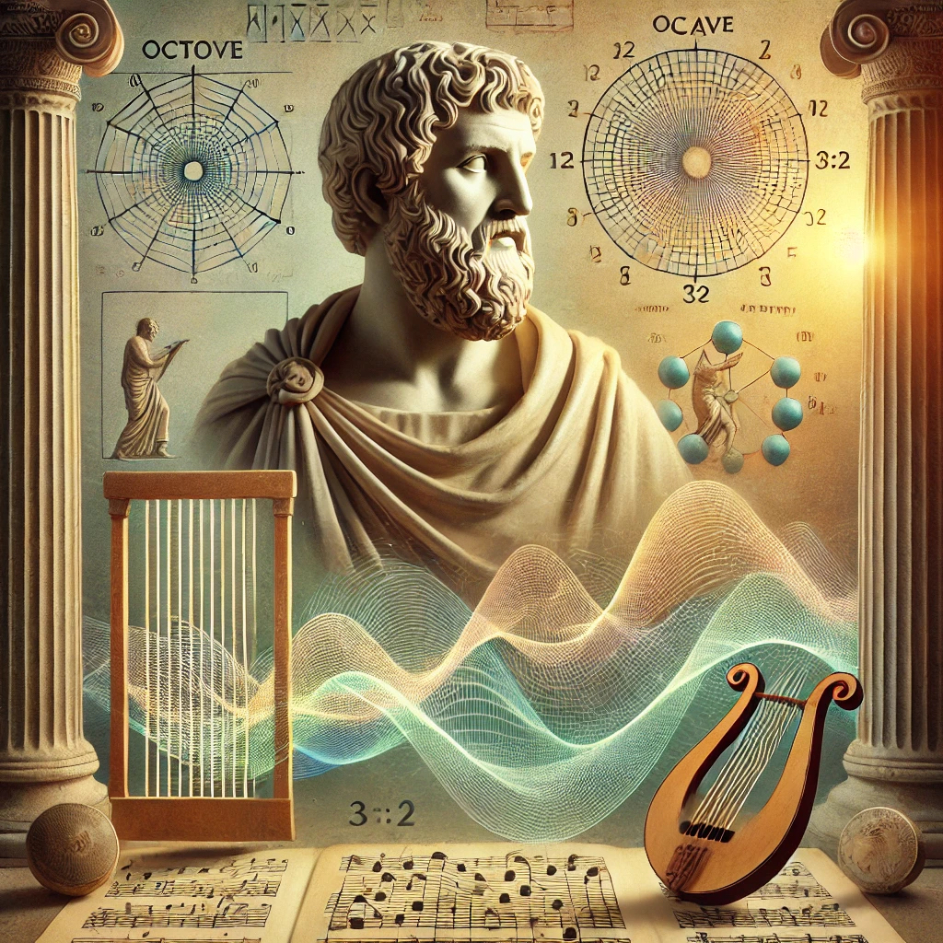
Historical Origins
The concept of tuning based on whole-number ratios was discussed by ancient Greek mathematicians and philosophers, including Pythagoras (c. 570–495 BCE). Pythagoras’ work focused on the overtone series and ratios like 2:1 (octave) and 3:2 (perfect fifth).The system was further refined in the medieval and Renaissance periods, notably by theorists such as Guido of Arezzo (11th century) and Zarlino (16th century), who explored intervals based on ratios like 5:4 (major third).

Slide 14
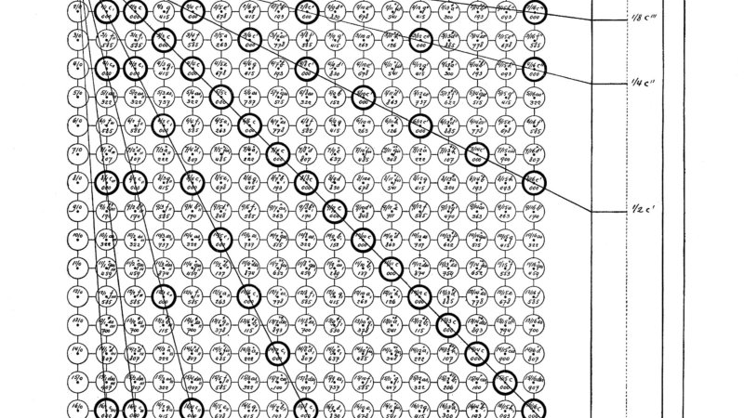
BARBARA HERO & THE LAMBDOMA

Slide 15
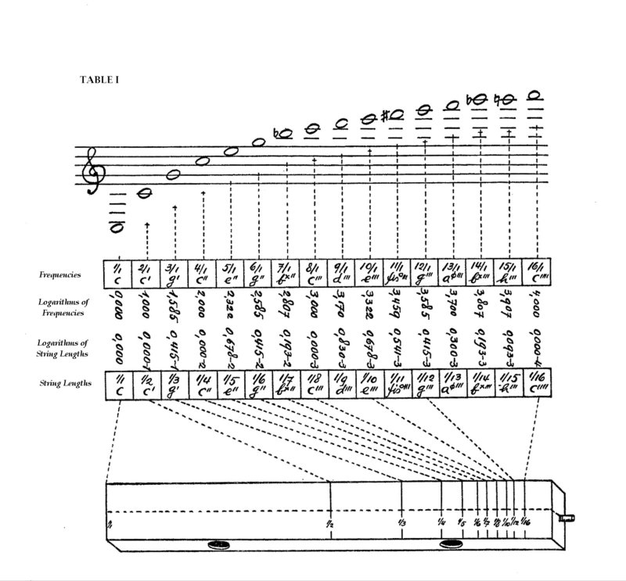
Barbara Hero's Research on the Lambdoma
The Lambdoma Matrix
Based on the work of Pythagoras, Hero developed the Lambdoma as a grid that visually represents harmonic relationships between musical frequencies.
Each position in the matrix corresponds to a ratio that can be translated into a specific tone or frequency, reflecting harmonic balance.
Applications in Sound Healing
Hero believed that the harmonic frequencies from the Lambdoma could align with human energy fields, facilitating physical, emotional, and spiritual healing.
She developed methods to use these frequencies for therapeutic purposes, aligning them with chakras, meridians, and other energetic systems.
Patrick Pagano studied and advanced Barbara’s methods after studying with Barbara from 1993-2008

Slide 16

RESEARCH
The present study reexamines the hypothesis that there exist emotional attributions specific to simple musical elements. In Experiment 1, groups of participants, with varying musical expertise, rated the emotional meaning of four natural intervals heard as two harmonic sine waves.
In Experiment 2, the higher tone was kept constant at an octave above the low tone used in Experiment 1, while the lower tone was constant.
Attributions for each interval were positively correlated from one experimental session to another; despite the intervals differed in terms of their component pitches. Musicians gave the most reliable choices of meaning. In a third experiment, participants rated the emotional meaning of various unfamiliar ethnic melodies with expressions describing the intervals’ meaning based on the results of Experiment 1 and 2. There were distinct profiles of emotional meanings for each melody and these coincided with the meaning of intervals that constituted the surface and deep structure of each melody. The intervallic structures (i.e., the main intervals of the tunes) and respective chords for each melody were also presented aurally and participants’ ratings showed similar emotional profiles for these when compared to those of the melodies themselves.

Slide 17
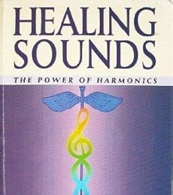
POWER OF HARMONICS
Resonance: The idea that sound vibrations can influence the vibrational frequencies within the body.
Entrainment: The synchronization of biological rhythms to external rhythms, such as sound frequencies.
Harmonic Alignment: Using pure intervals to align the body's energy centers and promote balance.
Reference:
Goldman, J. (2002). Healing Sounds: The Power of Harmonics. Inner Traditions/Bear & Company. [ISBN: 9780892819935]

Slide 18
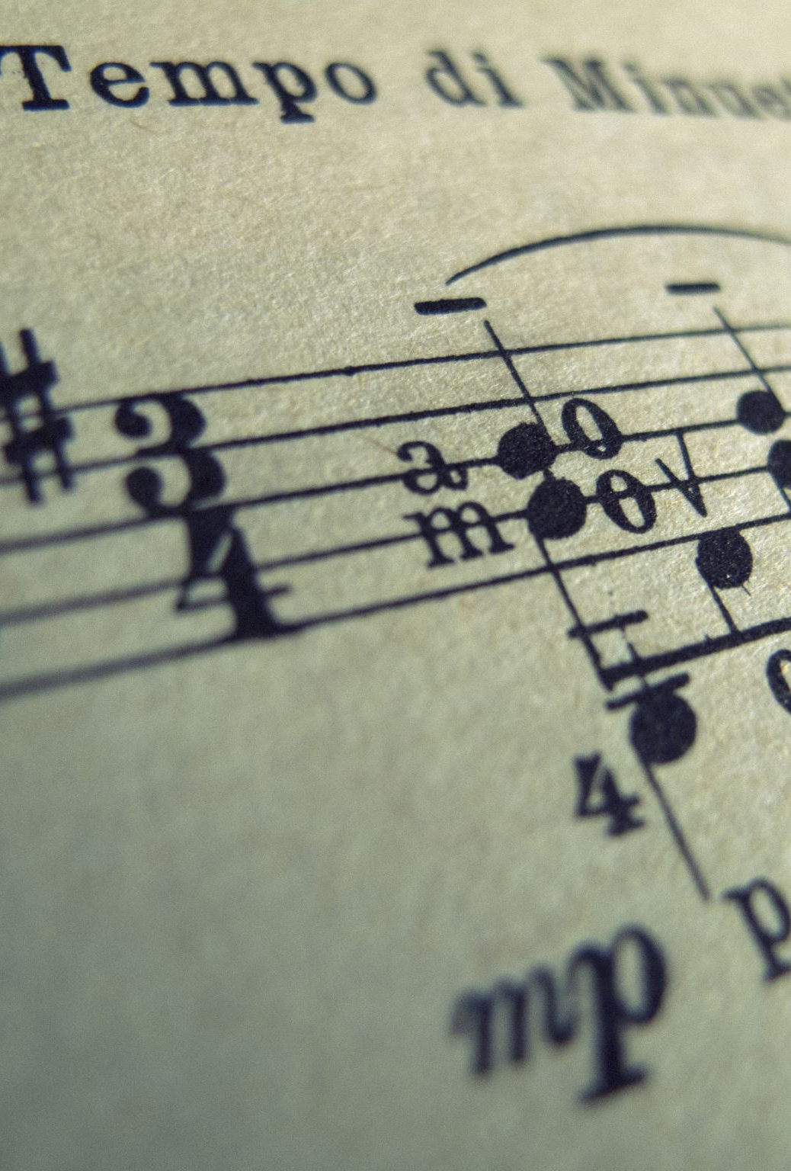
A Rigorous Test of the Proposition That Musical Intervals Have Different Psychological Effects
Timothy F. Maher
The American Journal of Psychology, Vol. 93, No. 2 (Jun., 1980), pp. 309-327 (19 pages)
https://doi.org/10.2307/1422235

Slide 19

Uncovering potential distinctive acoustic features of healing music
Background Music therapy is a promising complementary intervention for addressing various mental health conditions.
Aims This study aimed to identify and validate distinctive acoustic features of healing music.
Methods We constructed a healing music dataset (HMD) based on nominations from related professionals and extracted 370 acoustic features. Healing-distinctive acoustic features were identified as those that were (1) independent from genre within the HMD, (2) significantly different from music pieces in a classical music dataset (CMD) and (3) similar to pieces in a five-element music dataset (FEMD). We validated the identified features by comparing jazz pieces in the HMD with a jazz music dataset (JMD). We also examined the emotional properties of the features in a Chinese affective music system (CAMS).
Results The HMD comprised 165 pieces. Among all the acoustic features, 74.59% shared commonalities across genres, and 26.22% significantly differed between the HMD classical pieces and the CMD. The equivalence test showed that the HMD and FEMD did not differ significantly in 9.46% of the features. The potential healing-distinctive acoustic features were identified as the standard deviation of the roughness, mean and period entropy of the third coefficient of the mel-frequency cepstral coefficients. In a three-dimensional space defined by these features, HMD’s jazz pieces could be distinguished from those of the JMD. These three features could significantly predict both subjective valence and arousal ratings in the CAMS.
Conclusions The distinctive acoustic features of healing music that have been identified and validated in this study have implications for the development of artificial intelligence models for identifying therapeutic music, particularly in contexts where access to professional expertise may be limited. This study contributes to the growing body of research exploring the potential of digital technologies for healthcare interventions.

Slide 20
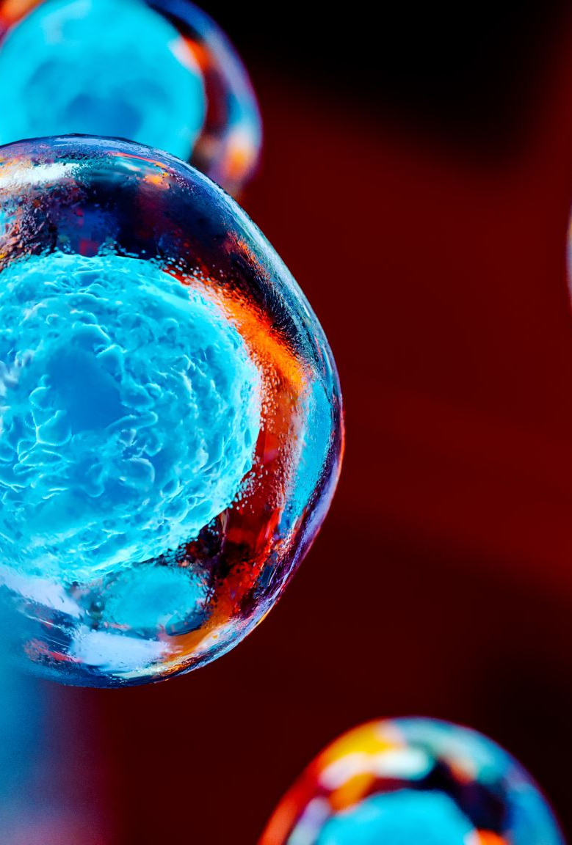
On the Neural Mechanisms of Music Therapy in Mental Health Care: Literature Review and Clinical Implications
Abstract
This article reviews literature from various disciplines in order to provide a conceptual framework for the neural mechanisms of music therapy in mental health treatment. Literature on the neurobiology of music-mediated emotion reveals distinct roles of several anatomical structures and neurotransmitters, many of which are also implicated in mental health disorders. Music’s impact on these neural correlates is dependent upon several factors, such as harmonic structure, autobiographical relevance, the presence of multimodal stimuli, and level of music training. Music is also capable of activating specific neural networks through either music listening or active music-making, with distinct networks involved in different types of musical experiences. This article explores the neurobiological basis of music-induced emotion associated with each of the four types of music therapy experiences—receptive, re-creative, improvisational, and compositional. Clinical implications for music therapists in mental health settings are discussed. Music is also a known modulator of the neurochemistry of trust and social affiliation, highlighting its ability to help establish therapeutic connections. Relevant literature is examined regarding the neural mechanisms of effective music therapy and psychotherapy interventions in mental health treatment. Music Therapy Perspectives, Volume 33, Issue 2, 2015, Pages 128–141, https://doi.org/10.1093/mtp/miv025

